Slide 1
Carbon compounds

Slide 2
Warm up
What makes Carbon special?
Todays notes will be taken on your own paper and checked off for participation
FFA Week Next week
Movie Night Feb 22nd
Chapter Meeting Feb 23rd

Slide 3
Introduction
Which is better for you: carbohydrates or sugars?

Slide 4
Carbohydrates
Carbohydrates are a key source of energy
Notes:
Found in most foods, especially fruits veggies, grains

Slide 5
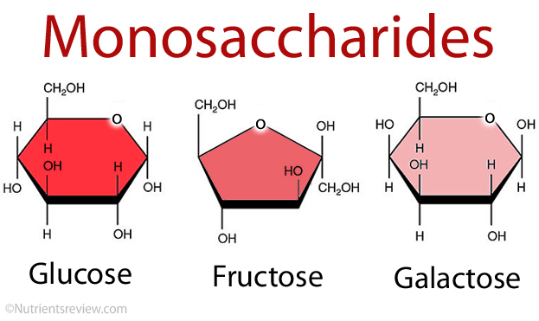
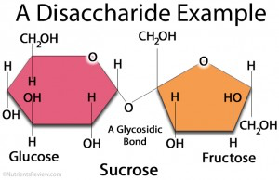
Carbohydrates
Made of single sugars called monosaccharide
Disaccharides are double sugars

Slide 6
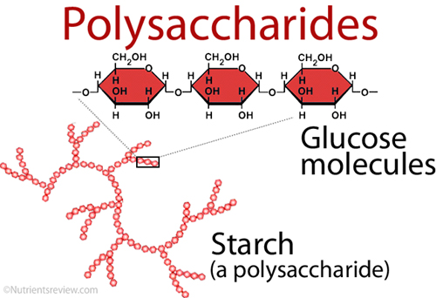
Polysaccharide
Based on name, what do you believe is the definition
3 or more monosaccharides

Slide 7
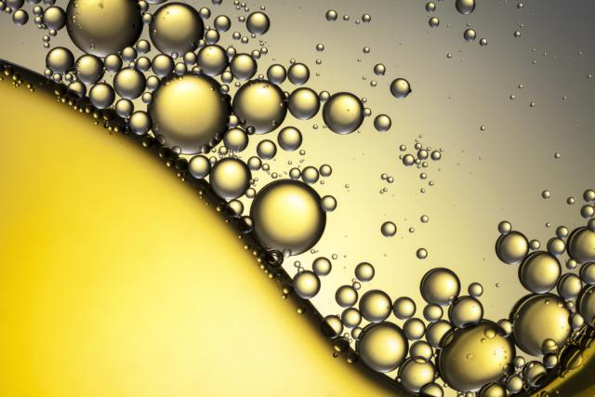
Lipids
Nonpolar molecules that are not soluble or mostly insoluble in water

Slide 8
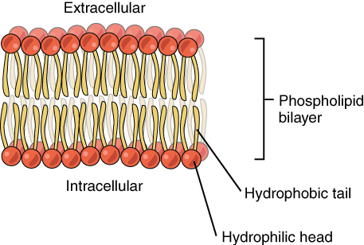
Types of lipids—phospholipid
Important in cells because they make up the cell membrane
Phospholipid polar or nonpolar?

Slide 9
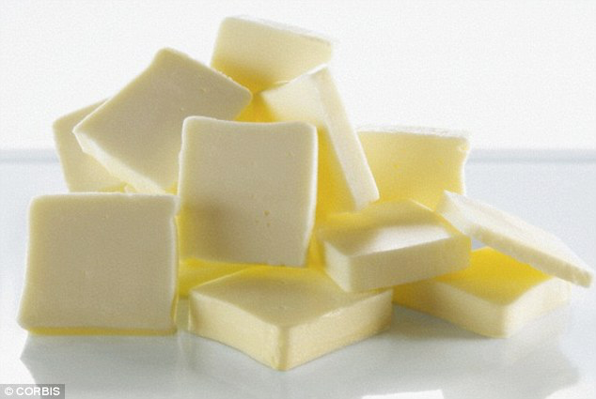
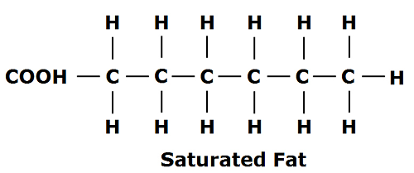
Types of lipids—fats
Lipids that store energy
Two types unsaturated and saturated
Saturated: all carbons have 2 hydrogens

Slide 10
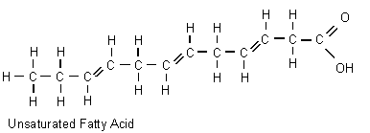
Unsaturated fatty acids
Some carbons are double bonded

Slide 11
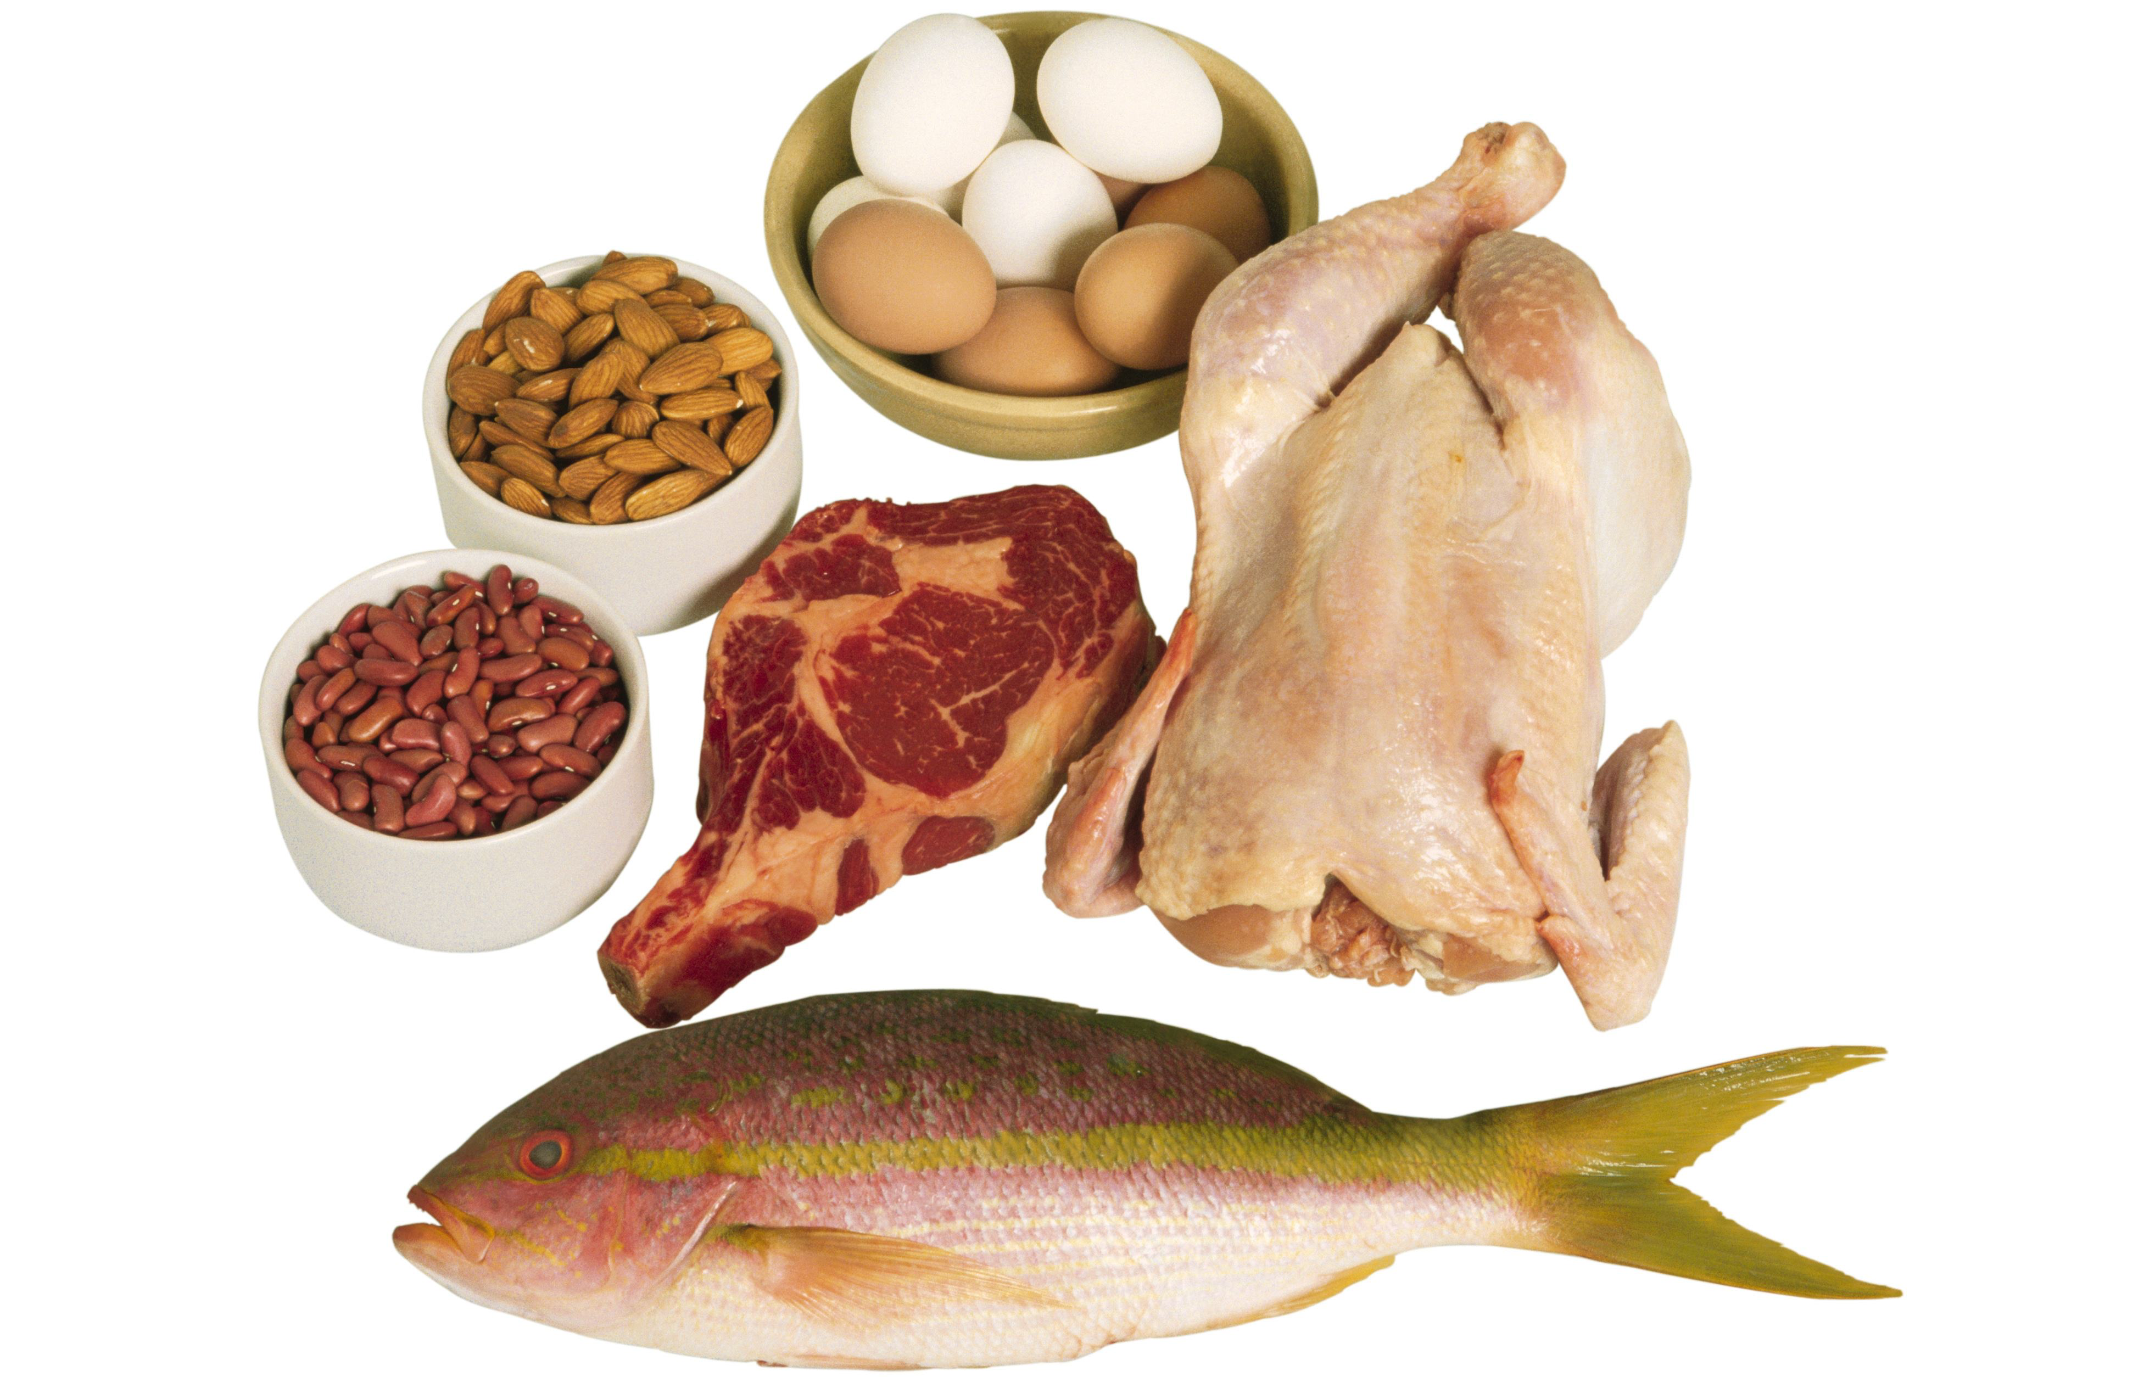
Proteins
Can promote chemical reactions
Hold structures together: ligaments and bones,
Antibodies: fight infections
Do the “Work” in the cell

Slide 12
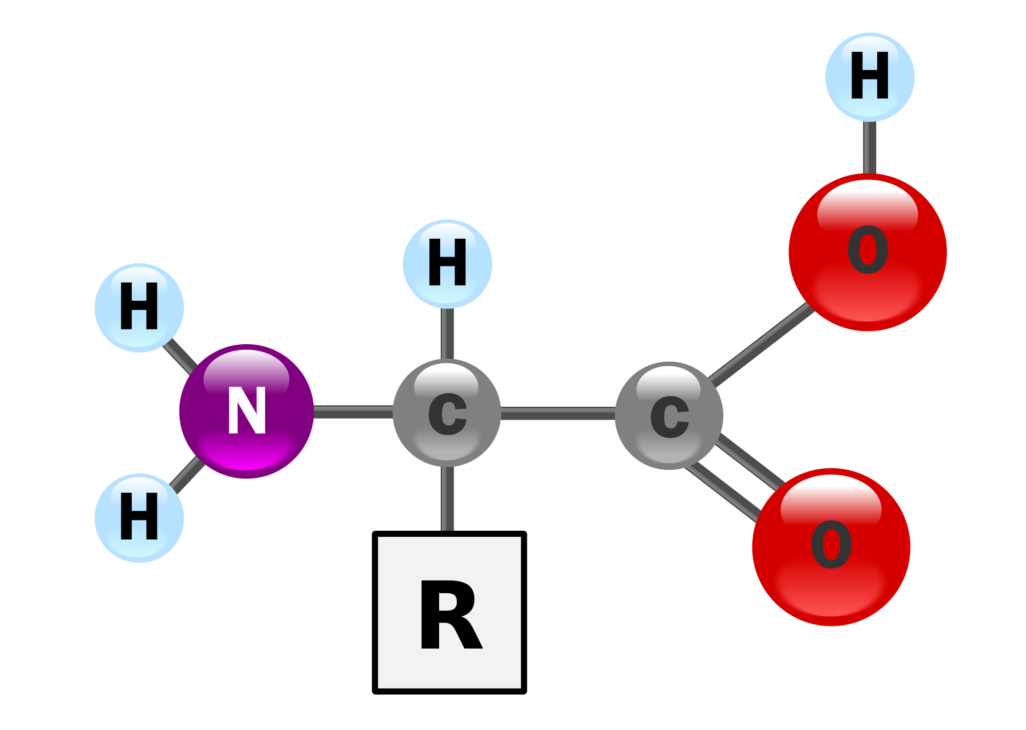
Protein structure
Made of amino acids
Amino acids are the building blocks of protein
20 different amino acids
Interact in polar and non-polar interactions to give shape to protein

Slide 13
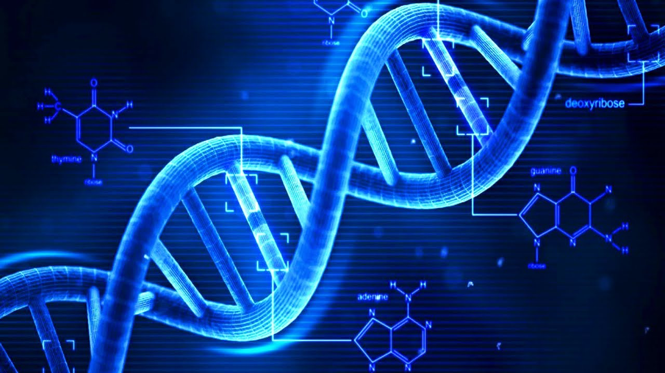
Nucleic Acid
DNA or RNA
Made of nucleotides or the AGTC In DNA

Slide 14
Review
What are the four types of carbon compounds?
Note check each other
Swap notes with the person next to you and ensure that they have the following:
Four types of carbon compounds
One defining feature for each

Slide 15
Study Time!
=)

Slide 16
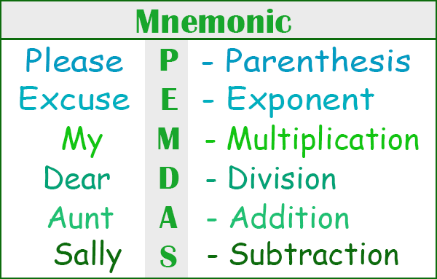
Mnemonic device
4 groups
Carbs
Lipids
Proteins
Nucleotides
Come up with a mnemonic device to remember the important information about your topic

